Slide 1
EMPLOYEE MANAGEMENT SYSTEM
BY:
ANSHUL KUMAR
206625

Slide 2
AGENDA
Introduction
Functionalities
Database Structure
Code Walkthrough
Conclusion

Slide 3
INTRODUCTION
This project implements an Employee Management System using Python and MySQL.
It allows administrators to perform CRUD operations on employee data.

Slide 4
FUNCTIONALITIES
Admin Login/Signup
Add Employee
View All Employees
Update Employee Details
Delete Employee

Slide 5
DATABASE STRUCTURE
Tables used:
Admin (username, password, name)
Employees (emp_id, name, email, age, salary, department)

Slide 6
CODE WALKTHROUGH
Connect to MySQL Database
Admin Authentication (Login/Signup)
CRUD Operations on Employee Data

Slide 7
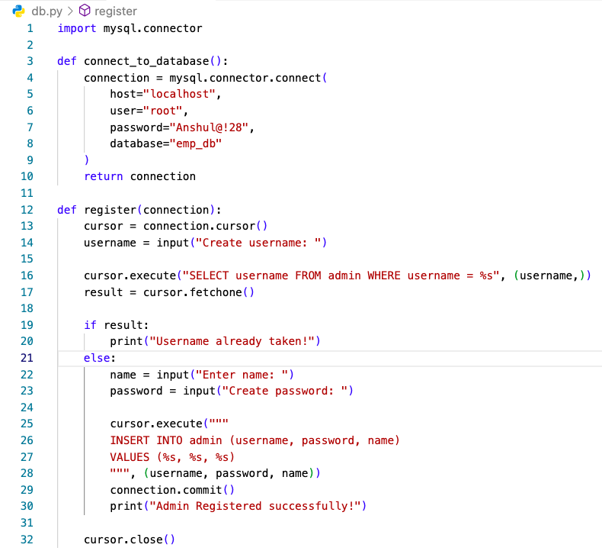
CONNECT TO MYSQL

Slide 8
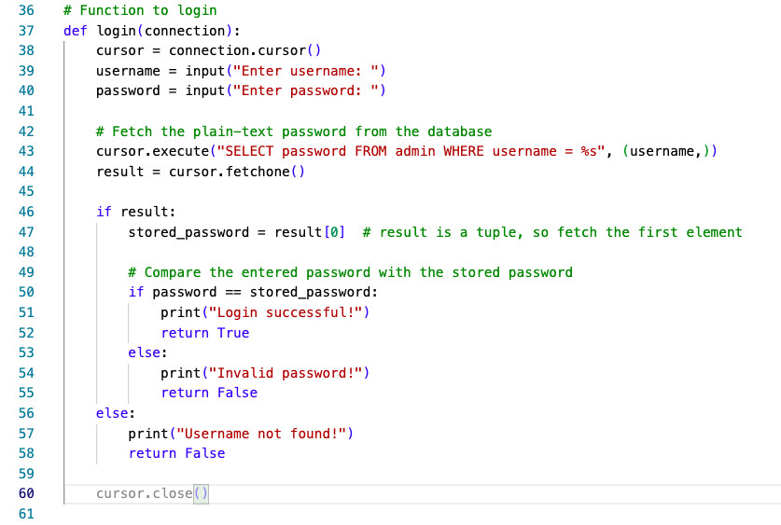
LOGIN AND PASSWORD VERIFICATION

Slide 9
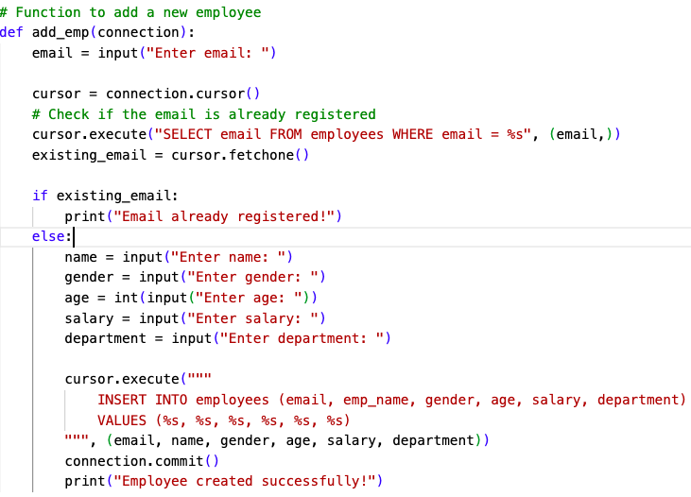
ADD EMPLOYEE

Slide 10
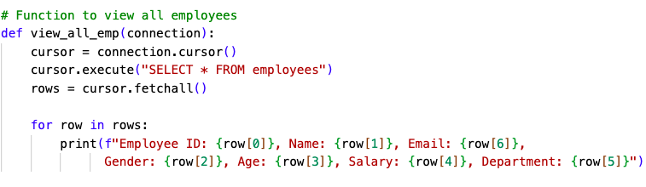
VIEW EMPLOYEES

Slide 11
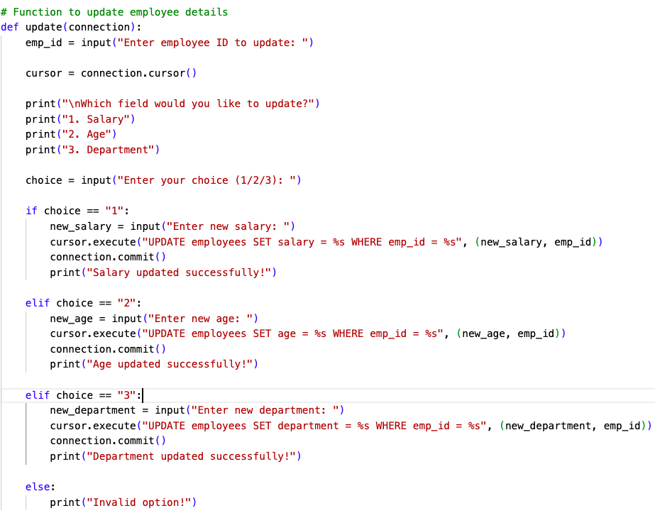
UPDATE EMPLOYEE DETAILS

Slide 12
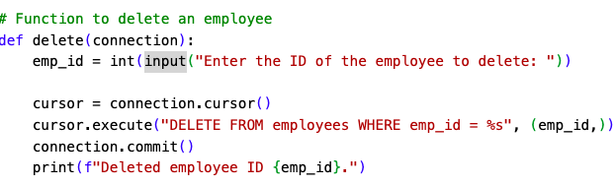
DELETE EMPLOYEE

Slide 13
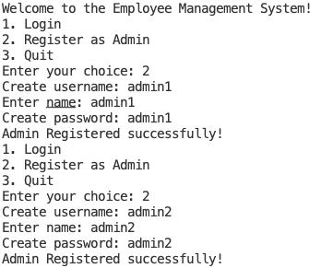
OUTPUTS

Slide 14
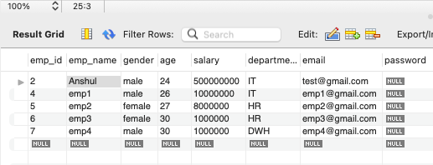
OUTPUTS

Slide 15
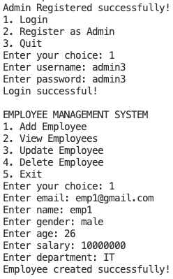
OUTPUTS

Slide 16
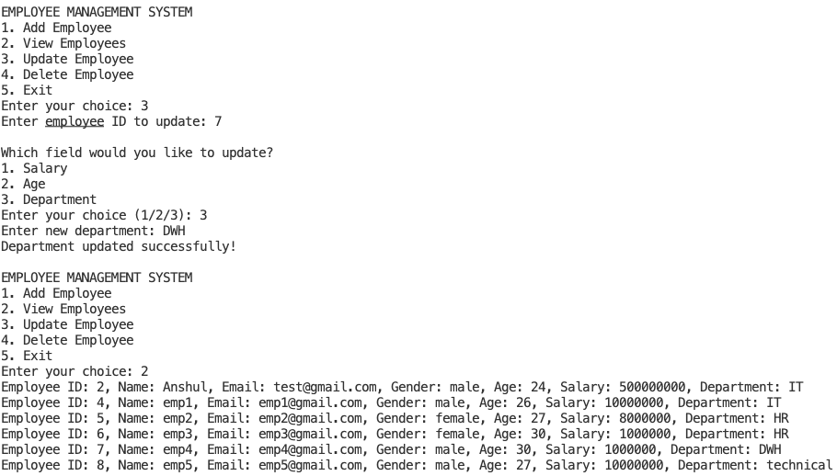
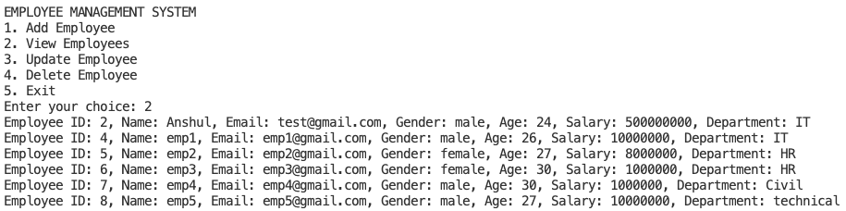
OUTPUTS

Slide 17
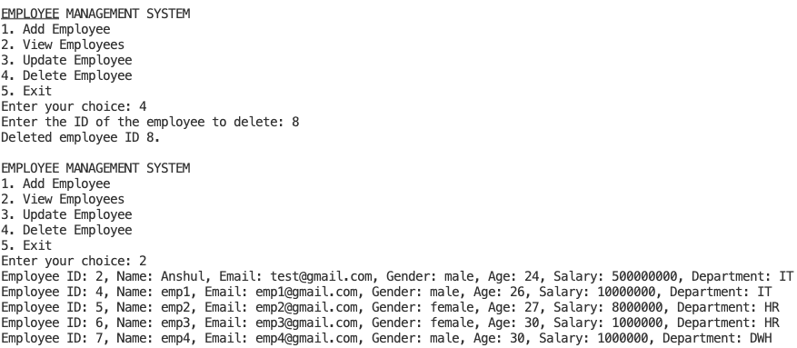
OUTPUTS

Slide 18
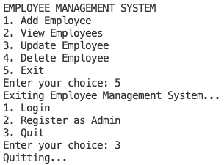
OUTPUTS

Slide 19
CONCLUSION
The Employee Management System is a basic console-based application that helps manage employee data using Python and MySQL.

